Slide 1
CSCI 5308: Budget Surfing
Group: 18
Client Team: 24
Team Members:
Neelansh Gulati
Parth Gondaliya
Hardee Garala
GRM Vishnu
Tuan Hamid

Slide 2
What application is trying to achieve?
Platform to organize and manage travel plans
User creation(host/traveler) via email confirmation
Trip creation by traveler
Keep track of expenses incurred during trip
Provide email-notifications if exceeding budget limit
Host can select traveler to stay at their property and provide feedback/rating
Traveler can make pre-payment (token-money) to the host

Slide 3
Project dashboard stats
Total Number of Tasks: 135
Task Completed By Individual
Neelansh Gulati: 26
Tuan Hamid: 22
Parth Gondaliya: 34
Hardee Garala: 26
GRM Vishnu: 27

Slide 4
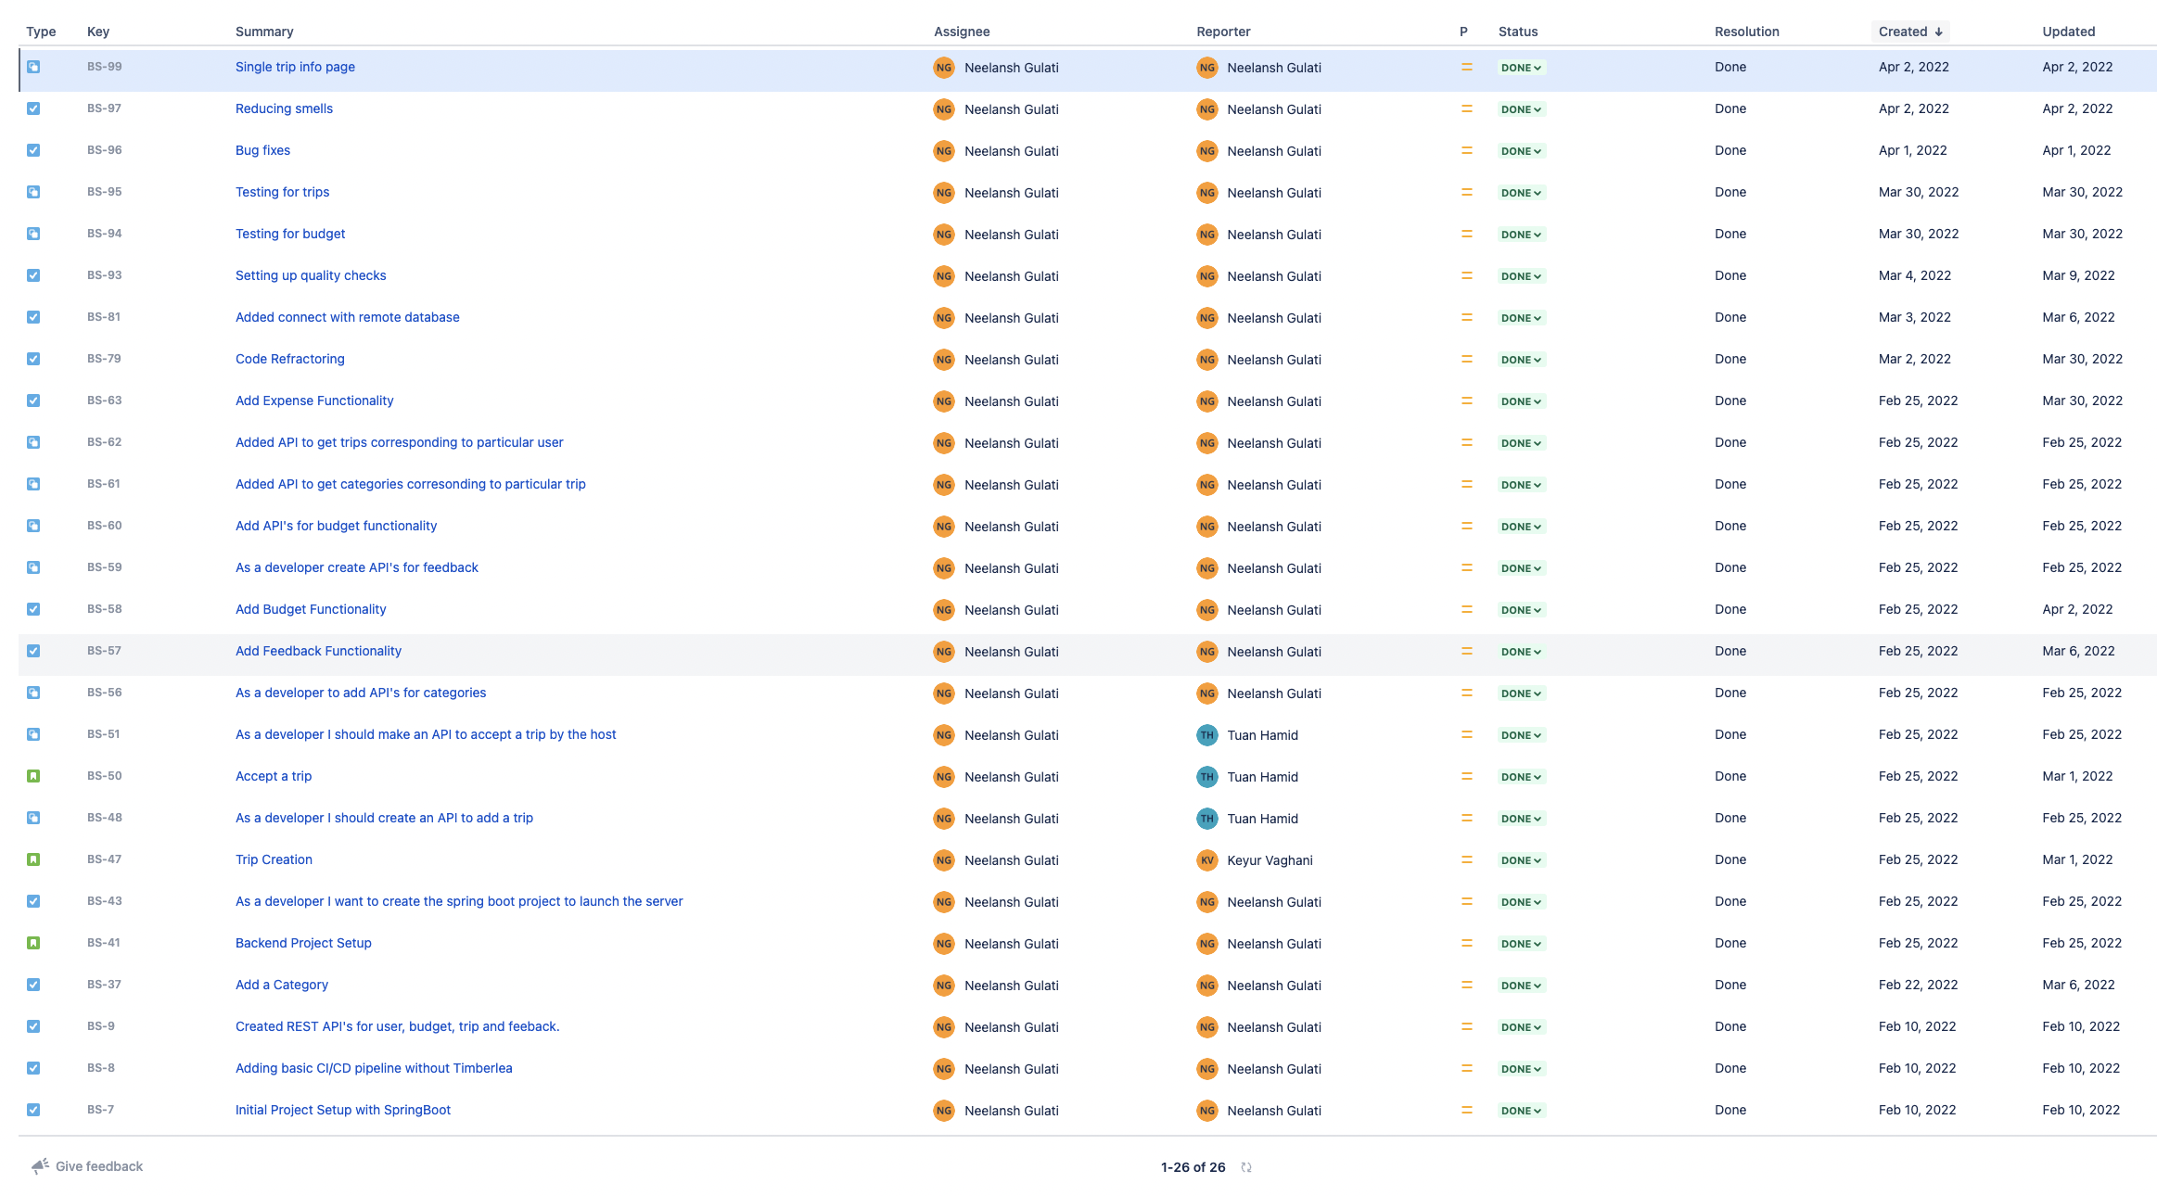

Slide 5
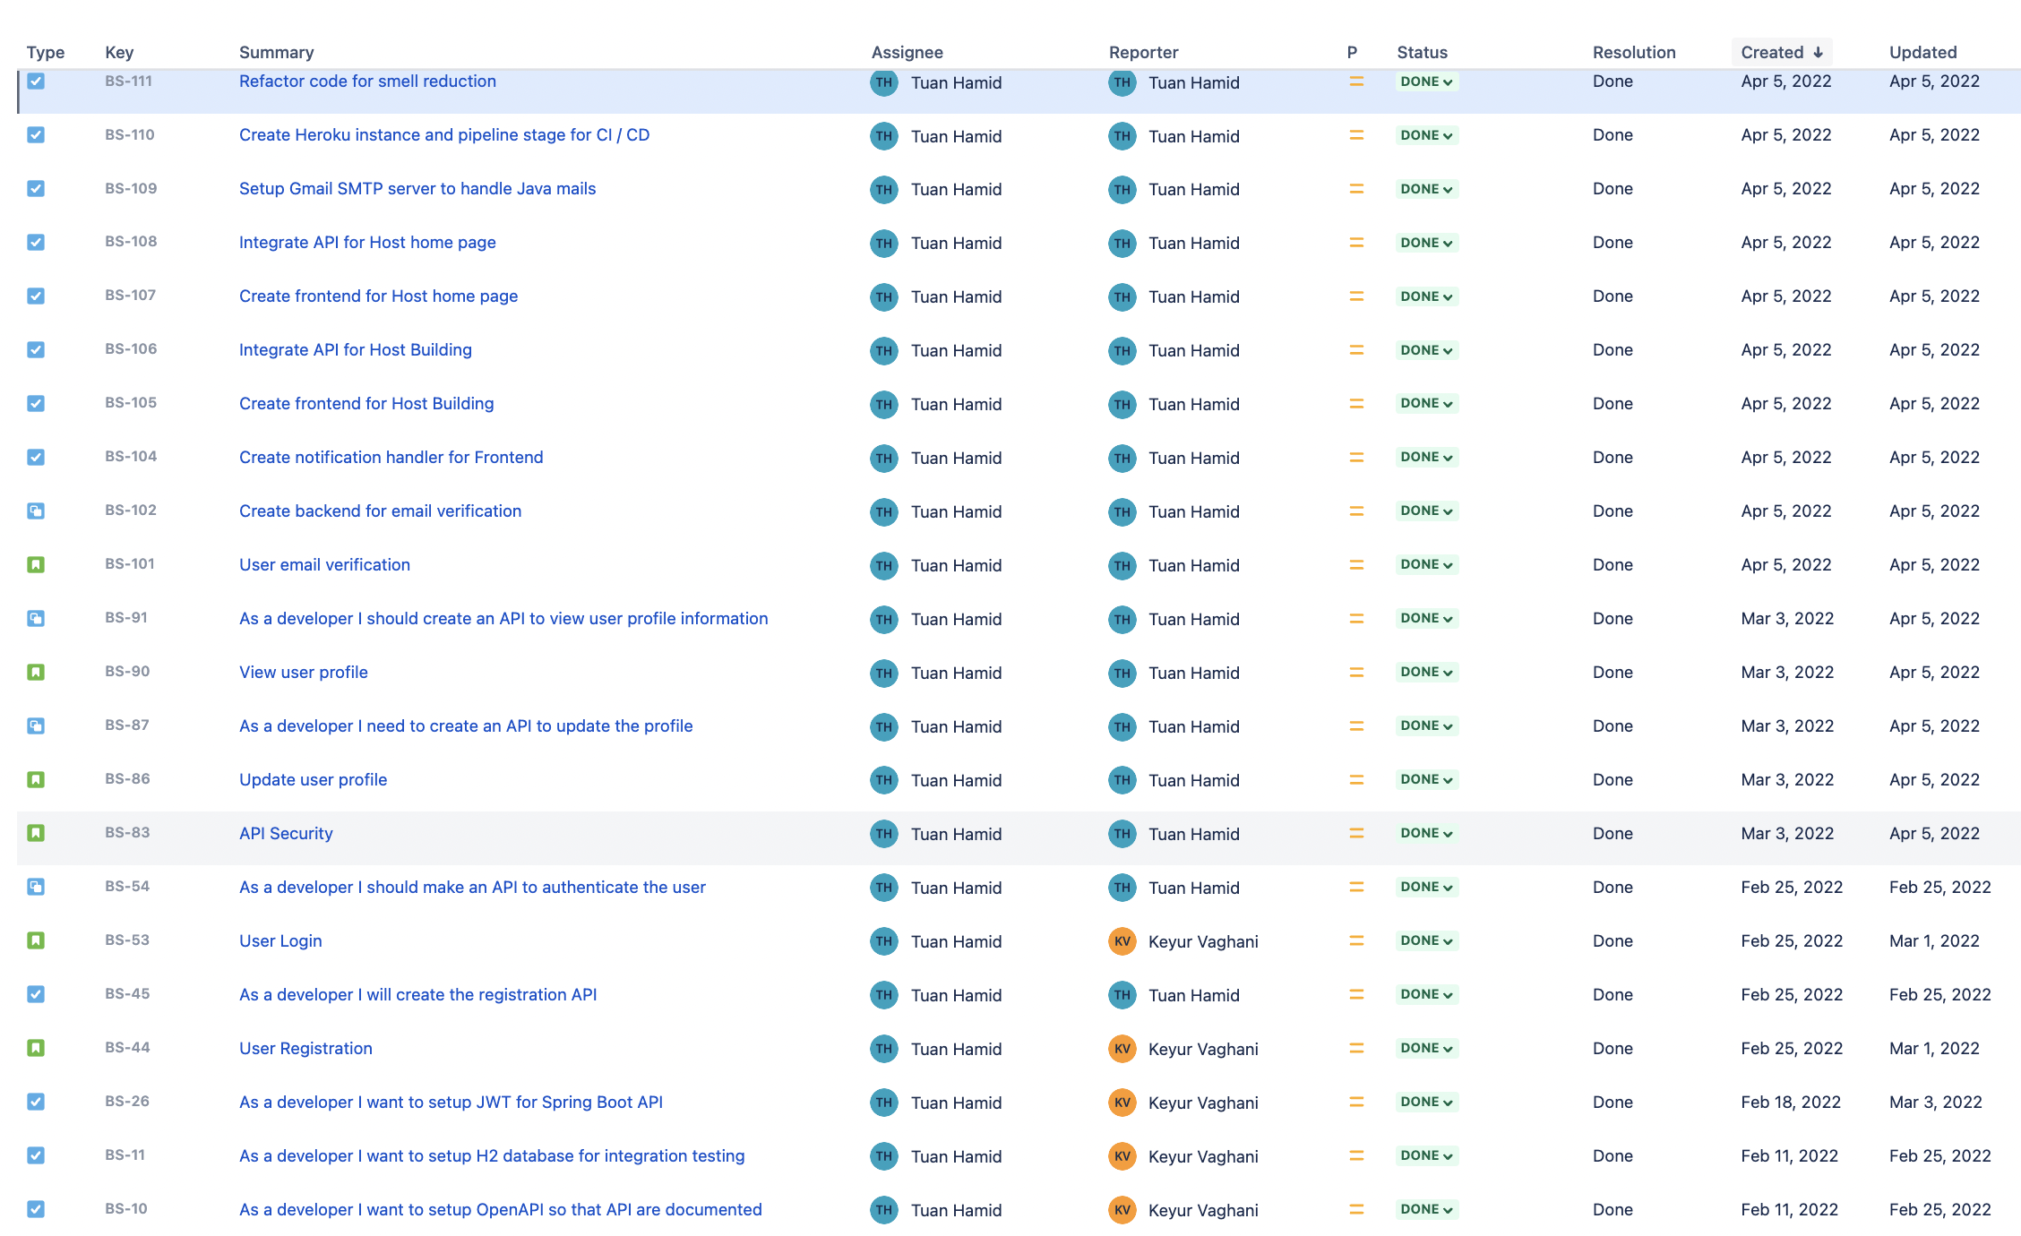

Slide 6
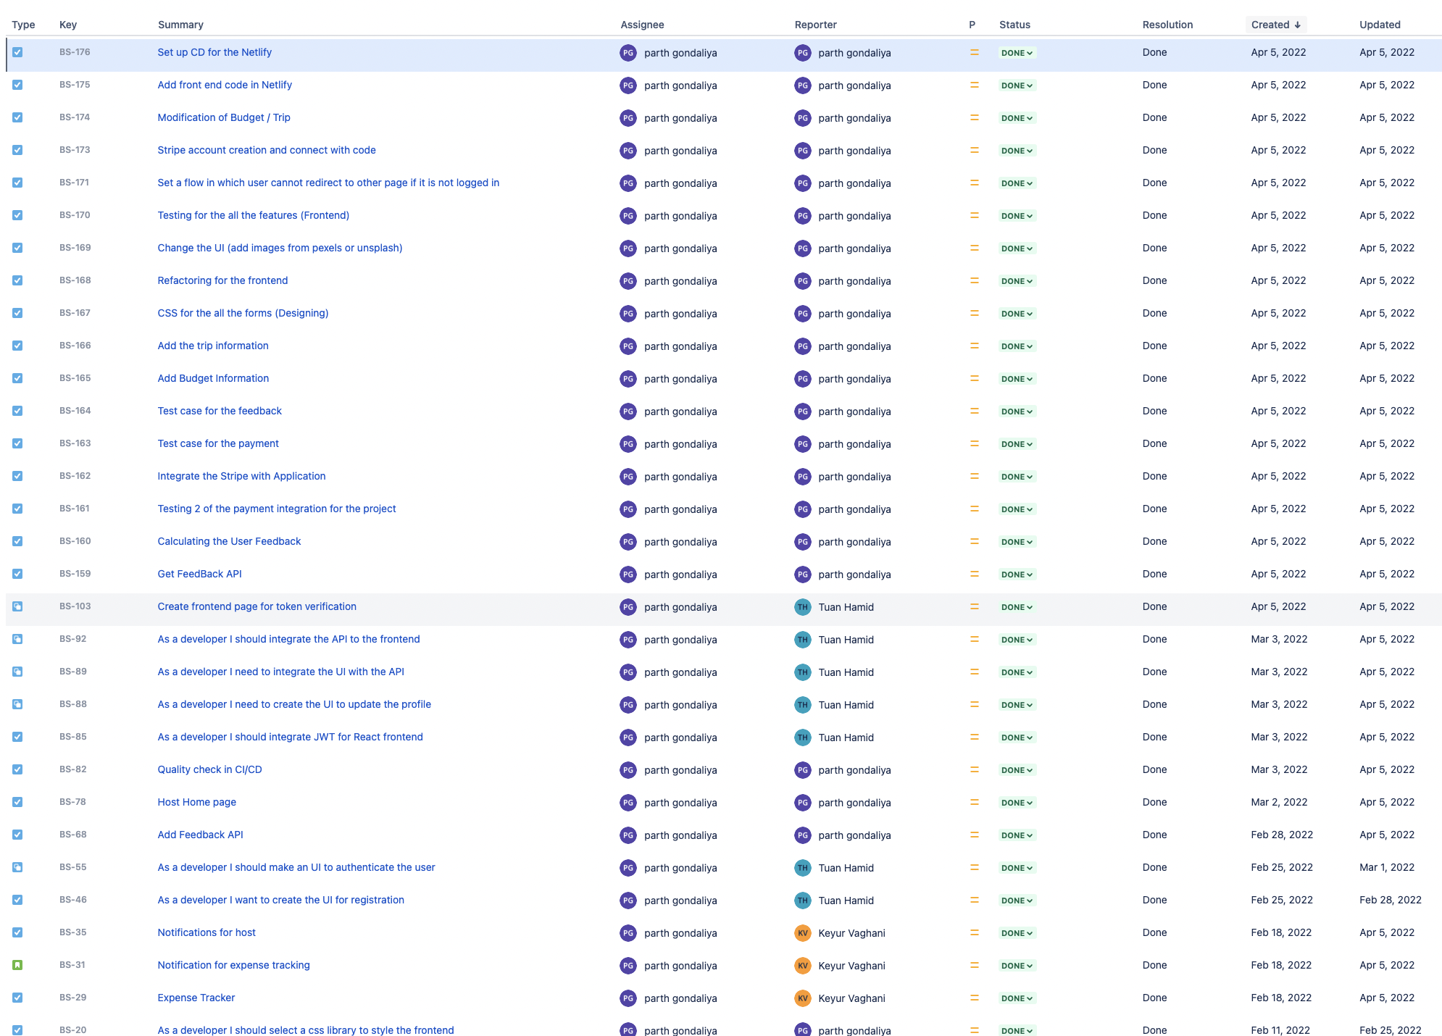

Slide 7
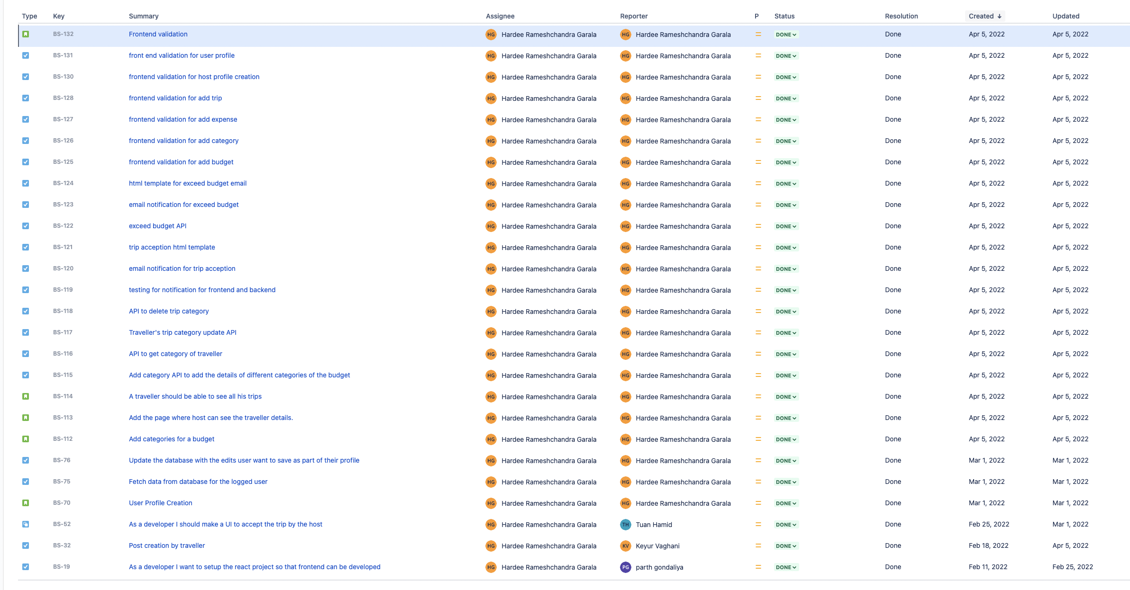

Slide 8
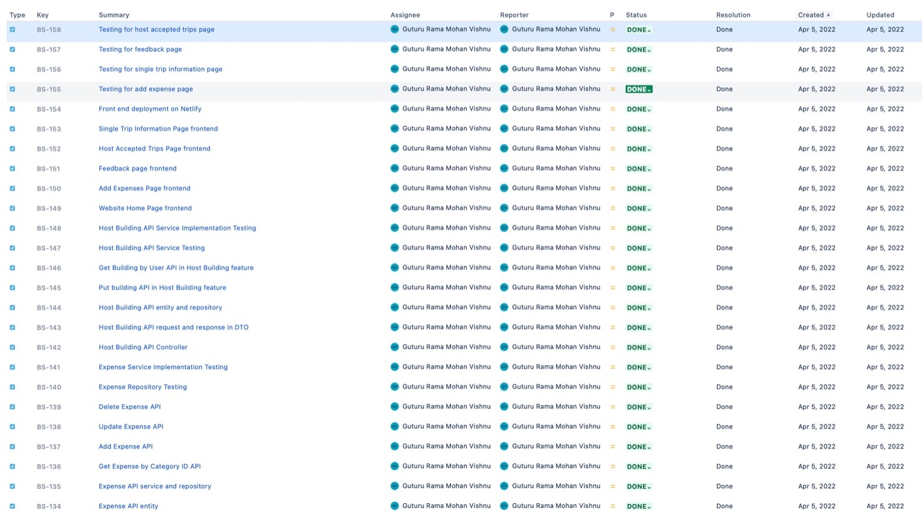

Slide 9
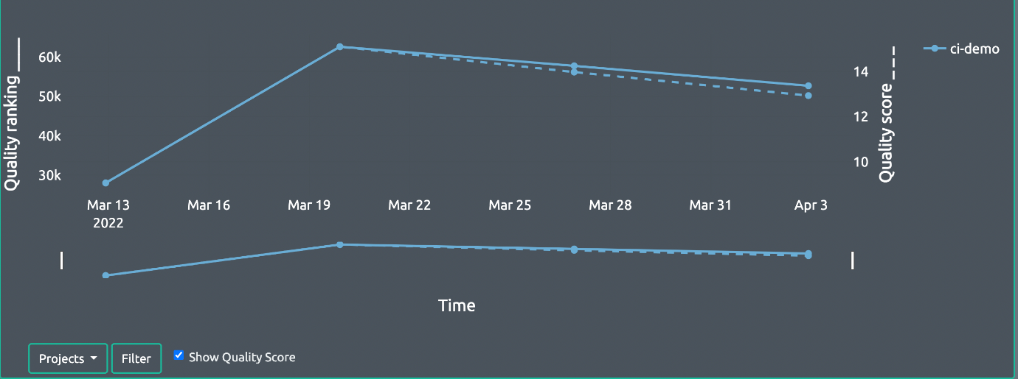
Quality ranking increasing over a period of time

Slide 10

Time for Demo

Slide 11
Project status w.r.t. final goals
Goals | Status
User Registration, Account verification through OTP sent on registered email, Login Module. | Achieved
Profile creation of users. | Achieved
Budget and Category planner module. | Achieved
Timely notifications if exceeding budget limits. | Achieved
Trip Creation of request by traveler. | Achieved
Acceptance of request by host from the list of all pending requests. | Achieved
Feedback or Rating about traveler. | Achieved
Expense tracker. | Achieved
Payment module using Stripe (Extra feature) | Achieved
Host building (Extra feature) | Achieved
Email notification module (Extra feature) | Achieved

Slide 12
Learning from the project
Difficult to accommodate last minute changes.
How to code keeping code quality, SOLID principles, and testing in mind.
How to work as a team professionally following Agile methodology and adapting to challenges.
Handle meetings and project work side-by-side.
Entire project workflow from project setup to deployment.
Handling client expectations and demands.

Slide 13
Steps to follow if given a chance to repeat
Backend pagination.
Chatbot feature.
2-way acceptance for host and traveler.
Stick to functionality decided before and not have last minute changes.
Ensure sufficient time for testing (more the better).
Everyone in team should have complete knowledge of modules of peers.
Stick to SOLID principles and coding standards to avoid rework.
Have complete clarity with client team before starting to work on any module.

Slide 14

Thank You!
Any Questions?

